Slide 1
The Forward-forward Algorithm
MIPT
Hakob Petrosyan, 06.04.2023

Slide 2
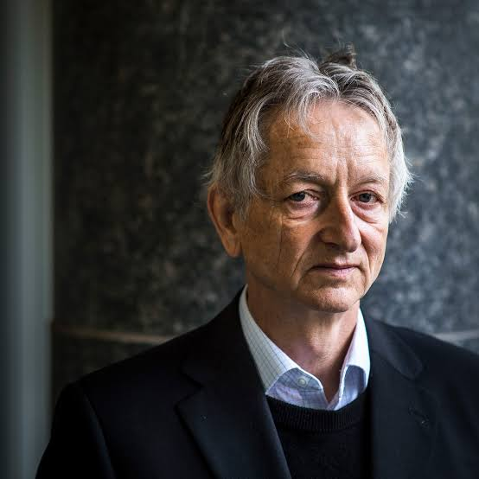
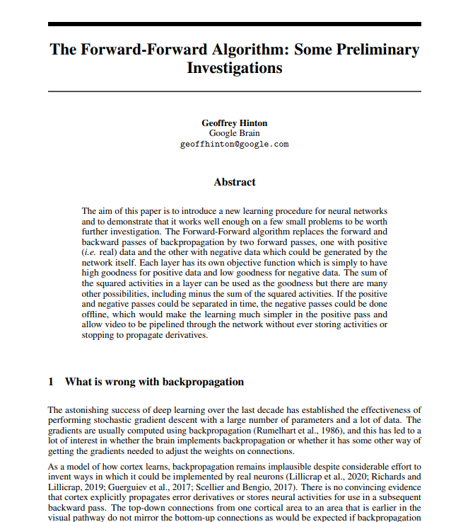
Intro
The forward-forward algorithm
Some experiments with forward-forward
The relevance of FF to analog hardware and mortal Computation
Code realization on CIFAR10 (bonus)
Geoffrey Hinton Geoffrey Everest Hinton CC FRS FRSC is a British-Canadian cognitive psychologist and computer scientist, most noted for his work on artificial neural networks. Since 2013, he has divided his time working for Google and the University of Toronto.
27 Dec 2022 https://arxiv.org/pdf/2212.13345.pdf

Slide 3
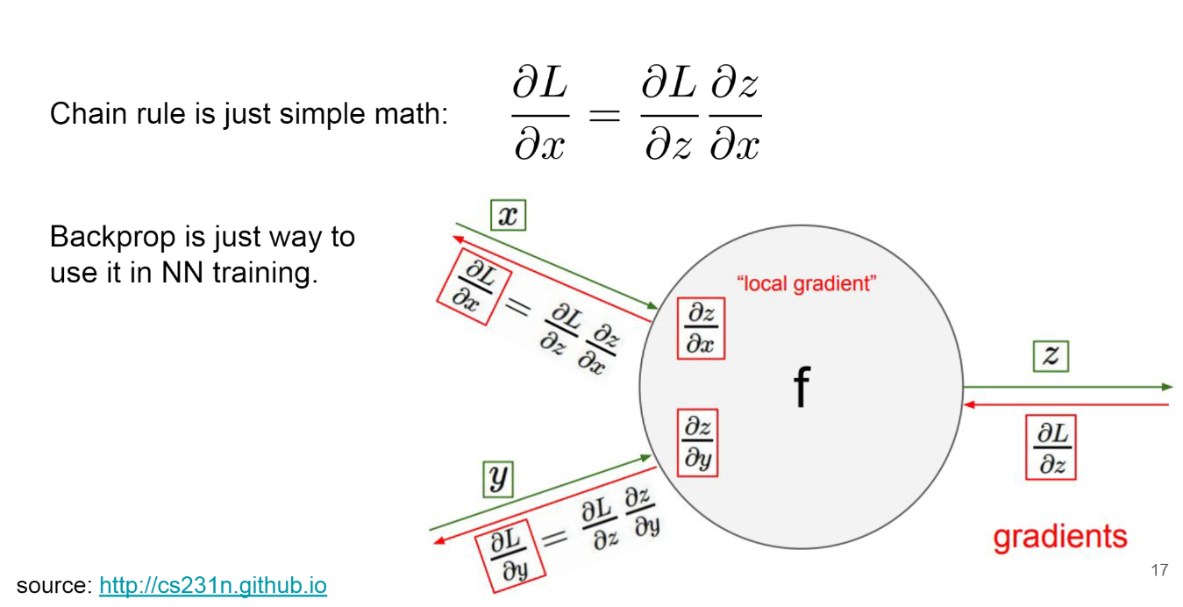
Backpropagation and chain rule
Cons:
The cortex works differently
Perfect knowledge of the computation performed in the forward pass to compute derivatives
The vanishing/exploding gradient problems
PS: RL methods are scaling badly vs backpropagation for large networks

Slide 4

Forward-forward
AI WORLD :D

Slide 5
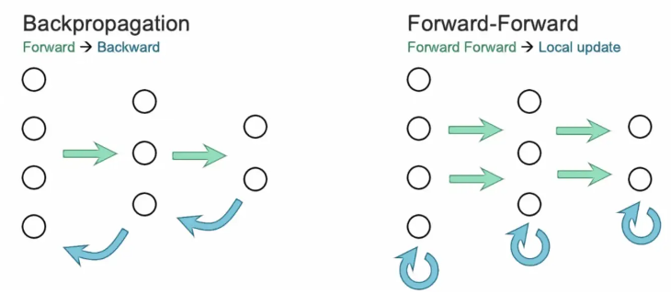
Forward-forward
Pros:
One more forward pass instead backpropagation pass
Learning without ever storing activities or stopping to propagate derivatives
Can be used with very low-power analog hardware
Cons:
Slower than backpropagation
Does not generalize as well as backpropagation
https://www.nebuly.com/blog/geoffrey-hinton-forward-forward

Slide 6
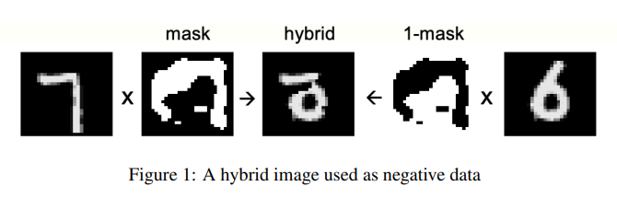
Algorithm overview
2 forward steps:
One for positive data
One for negative data
https://arxiv.org/pdf/2212.13345.pdf

Slide 7
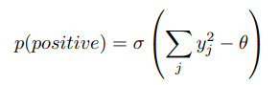
Algorithm overview [goodness]
2 forward steps:
Positive pass try to increase goodness
Negative pass try to decrease goodness
One of possible goodness functions:
The aim of the learning is to make the goodness be well above some threshold (theta) value for real data and well below that value for negative data.

Slide 8
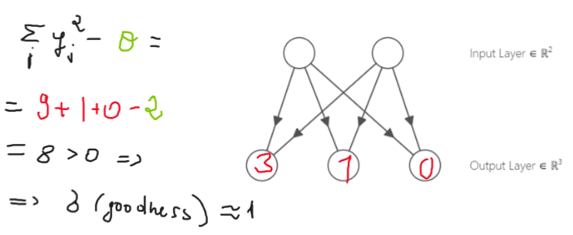
Algorithm overview [goodness Example]
goodness =

Slide 9
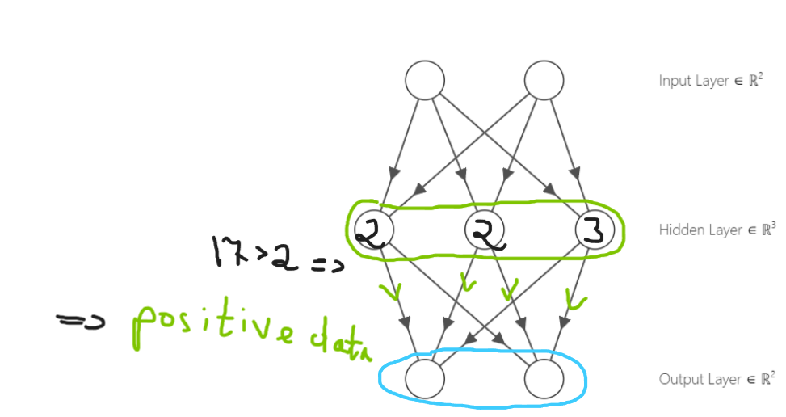
Algorithm overview [goodness Example]
Problem!
Next layer already knows that is positive!
goodness =

Slide 10
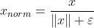
Algorithm overview [goodness Example]
Problem!
Next layer already knows that is positive!
Solution:
Layer normalization
goodness =

Slide 11
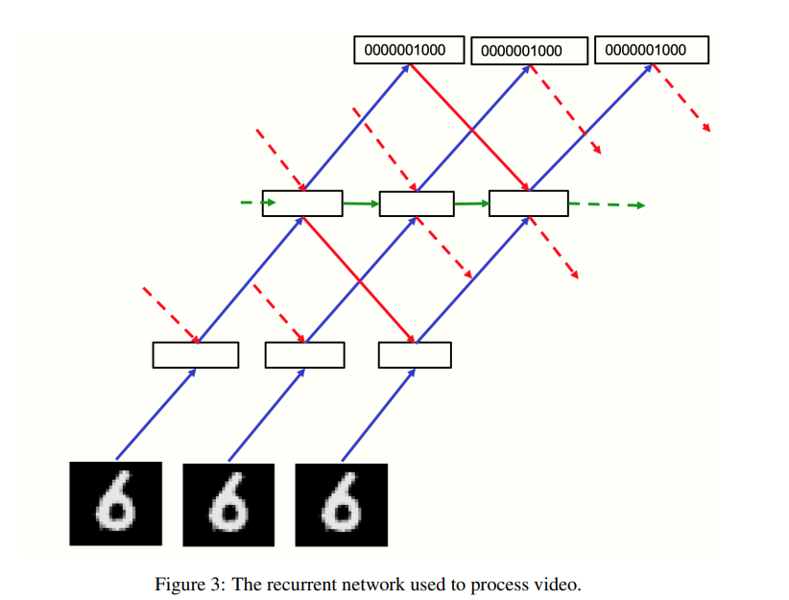
Algorithm overview
https://arxiv.org/pdf/2212.13345.pdf

Slide 12
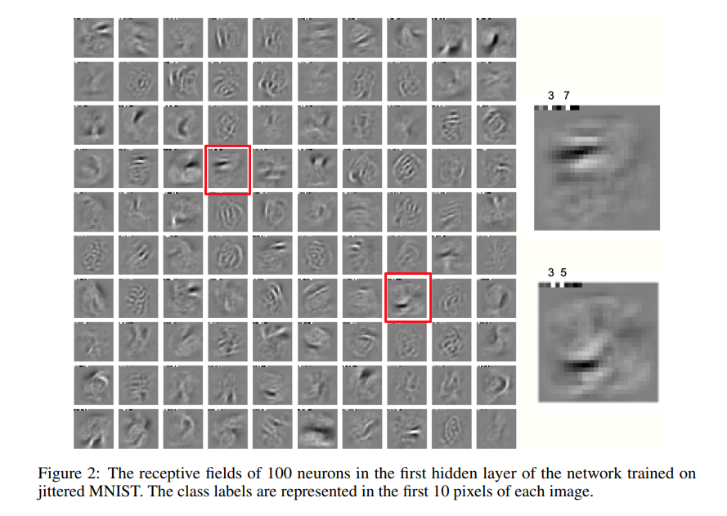
Algorithm overview
https://arxiv.org/pdf/2212.13345.pdf

Slide 13
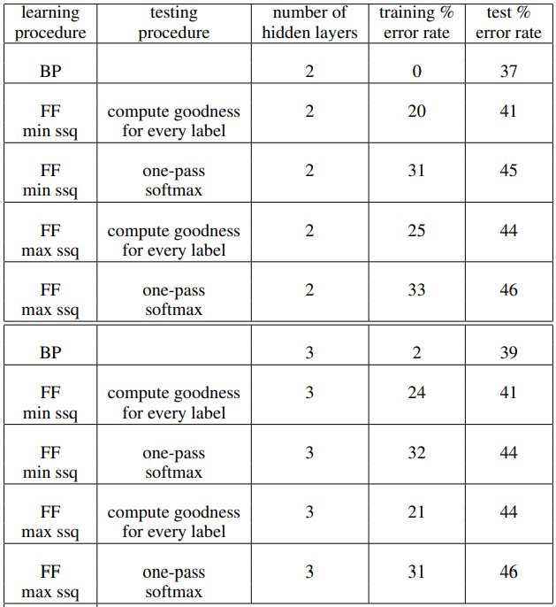
REsults
Table 1: A comparison of backpropagation and FF on CIFAR-10 using non-convolutional nets with local receptive fields of size 11x11 and 2 or 3 hidden layers. One version of FF is trained to maximize the sum of the squared activities on positive cases. The other version is trained to minimize it and this gives slightly better test performance.
https://arxiv.org/pdf/2212.13345.pdf

Slide 14
If you want your trillion parameters neural net to only consume a few watts, mortal computation maybe the only option. Its feasibility rests on finding a learning procedure that can run efficiently in hardware whose precise details are unknown, and the Forward-Forward algorithm is a promising candidate, though it remains to be seen how well it scales to large neural networks.
Geoffrey Hinton
https://arxiv.org/pdf/2212.13345.pdf

Slide 15
Thank You!

